Slide 1


Slide 2
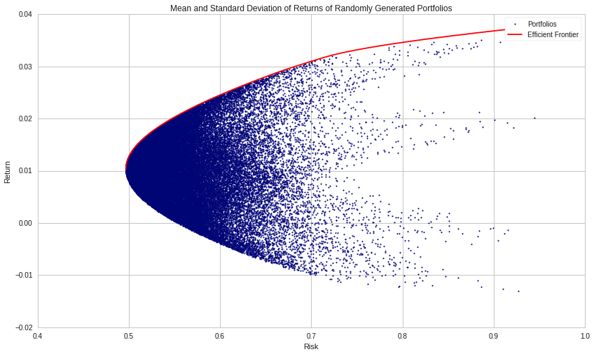
Markowitz Model
Find the efficient portfolios frontier basing on mean and variance.
Consider the covariance between assets to reduce risk.

Slide 3
Assumptions
Investor focused only on maximising the expected return and minimising variance.
Variance is the indicator for risk.
Considering only mean and variance (i.e. ignoring skewness and kurtosis) means implicitly assuming a normal distribution for the returns.

Slide 4
Why?
Few assumptions
Simple and easy to implement
Fast (in general)
Flexible, both for alternative choices and for enlarging

Slide 5
Implementation
A double optimisation problem: find first the reachable expected values (/ function to be maximised), then minimise the variance (/function to be minimised).
Classes and single assets requirements via linear constraints.
One year time horizon for mean/variance estimates: balance between short term prospective and reliable results.

Slide 6
Estimates Improvement I
Shrinkage estimators with views:
Bond: -0.1% (increasing rates)
Crypto: +3% (good performance and First Future Bitcoin ETF in New York Stock Exchange)
Equity and commodities: 0% (no clear view)

Slide 7
Estimates Improvement II
Resampling:
Balancing the number of frontier points and number of resamples to manage computational effort.
Security check on constraints compliance.

Slide 8
Value-at-Risk
Mild upper bound: to have a known bound rather than a harsh restriction.
Historical simulation approach:
No parametric assumptions.
Catching rare events previously occurred.
Possibility to add weights.
Two years time horizon so to include covid crisis.

